Slide 1




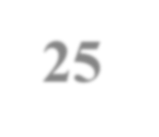
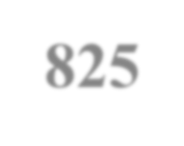
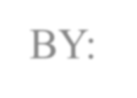
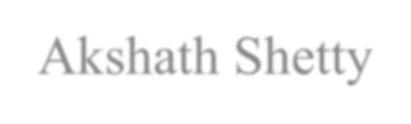
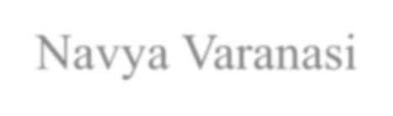
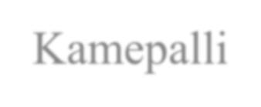
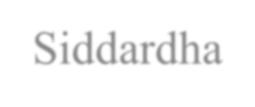
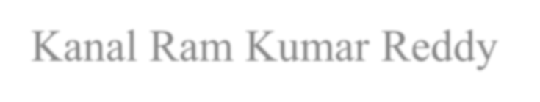
Supply Chain Analysis-CDACL-003
TEAM ID: PTID – CDA – NOV – 25 – 825
BY:
Akshath Shetty
Navya Varanasi Kamepalli Siddardha Kanal Ram Kumar Reddy

Slide 2
Project Objective
Core Objectives
Analyze end-to-end supply chain performance from supplier to customer delivery
Measure and compare KPIs across three product categories: Cosmetics, Haircare, and Skincare
Identify revenue drivers and highest-margin segments
Uncover operational bottlenecks in inventory, fulfillment, logistics, and quality
Detect data quality issues and anomalies affecting reporting accuracy
Evaluate supplier and shipping carrier effectiveness
Quantify impact of defects, delays, and stock-outs on profitability and customer satisfaction
Deliver data-driven, actionable recommendations to improve efficiency, reduce costs, and boost revenue
Scope of Analysis • 100 SKUs | 46,099 units sold | $577K revenue • 5 suppliers | 3 shipping carriers | 5 locations • Metrics covered: Revenue, Profitability, Stock Turnover, Fill Rate, On-Time Delivery, Defect Rate, Supplier Margin
Deliverables ✓ Interactive Power BI Dashboard (2 pages) ✓ Cleaned insights with root-cause analysis ✓ Prioritized recommendations with business impact ✓ Professional presentation for management review
Outcome Expected Enable data-driven decision making to increase on-time delivery >90%, reduce defects <1%, and grow Skincare-led revenue by 20%+ in the next cycle.

Slide 3
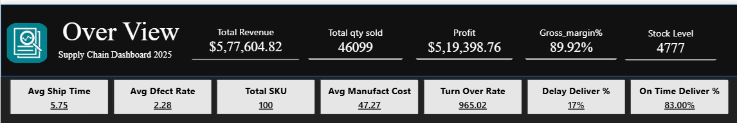
Dataset Overview
Summary of Core KPIs
Total SKUs: 100
Total Revenue: $5.77M
Total Quantity Sold: 46,099 Units
Total Profit: $5.19M
Gross Margin: ~89.9%
Average Defect Rate: 2.28%
Average Shipping Time: 5.75 Days
Turnover Rate: 965.02
On-Time Delivery %: 83%
Dimensions Analysed
Product (Cosmetics, Haircare, Skincare)
Supplier (5 suppliers)
Location (Bangalore, Chennai, Delhi, Kolkata, Mumbai)
Customer Demographics (Male, Female, Unknown)
Insights
Recommendations
Skincare is the largest revenue contributor ($2.41M), followed by Haircare
and Cosmetics.
Gross margin is extremely strong (~90%), indicating lower cost structures.
Average defect rate of 2.28% is acceptable but has room for reduction.
Turnover rate is high, showing strong movement of inventory.
On-time delivery at 83% signals a need to improve logistics efficiency.
Improve shipping efficiency by optimizing routes to boost on-time delivery beyond 90%.
Revisit suppliers with higher defect rates and renegotiate quality SLAs.
Increase focus on Skincare category as it drives majority revenue and profit.
Use predictive demand planning to reduce stock levels without impacting service rat

Slide 4
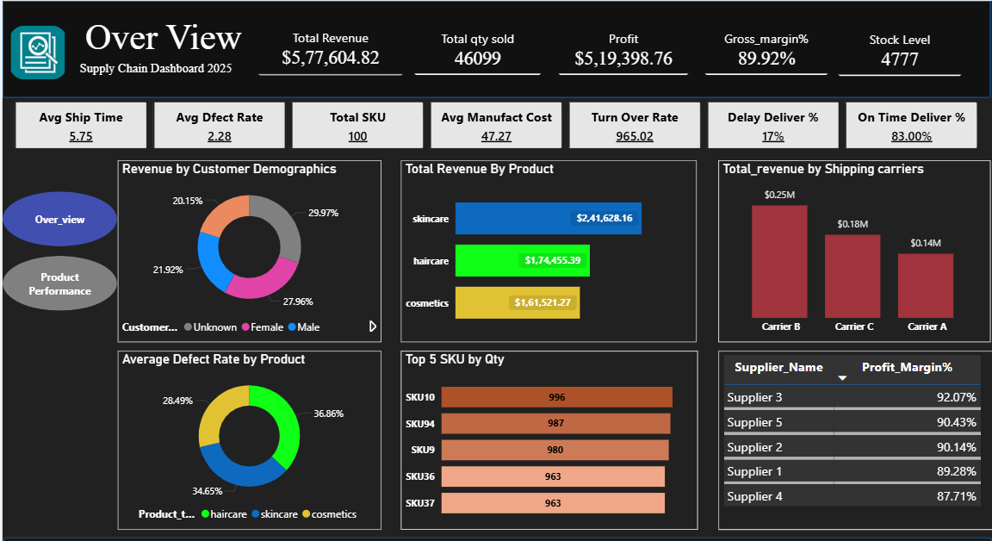
Over View Dashboard
Key Highlights from Overview
Skincare dominates revenue → $241.6K (42%)
Highest revenue carrier → Carrier B ($250K+)
Top 5 SKUs = 4,889 units (10% of total volume)
29% revenue from “Unknown” gender →
data quality issue
Recommendation
Make gender field mandatory in order system
Route 80%+ shipments via Carrier B

Slide 5
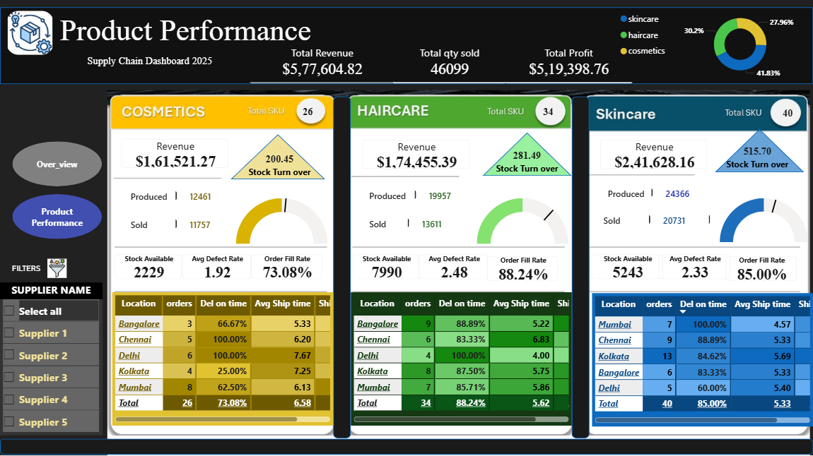
Product Performance Dashboard
Quick Observations
• Skincare: Highest revenue + balanced stock turn (15.7x) • Haircare: Insane stock turn of 281x → possible data error in few SKUs
• Cosmetics: Lowest order fill rate (73.08%) → planning/forecasting issue
Recommendation
Immediate data cleaning of “Number_of_products_sold”
Urgent fix needed for Cosmetics demand planning

Slide 6
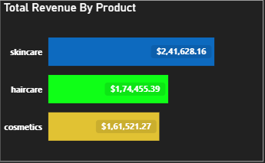
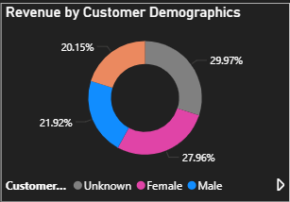
Revenue Breakdown
Revenue by Category
Skincare 42% ███████████
Haircare 30% ███████
Cosmetics 28% ██████
Revenue by Gender
Unknown 29.97%
Female 27.96%
Male 21.92%
Non-binary 20.15%
Insight: Almost 30% customers not tagged → improve CRM

Slide 7
Category Comparison
Category | Revenue | Units Sold | SKUs | Stock Available | Stock Turn | Fill Rate | Defect % | Winner?
Skincare | $241.6K | 20,731 | 40 | 5,243 | 15.7x | 85.0% | 2.33% | ★★★★
Haircare | $174.5K | 13,611 | 34 | 7,990 | 281x ?? | 88.2% | 2.48% | Data error
Cosmetics | $161.5K | 11,757 | 26 | 2,229 | 200x ?? | 73.1% | 1.92% | Needs urgent fix
Recommendation
Increase Cosmetics safety stock by 50%
Block reporting until “sold vs produced” data is corrected
insights
Cosmetics bleeding revenue due to low fill rate & low stock
Stock turn numbers are meaningless until data is cleaned

Slide 8
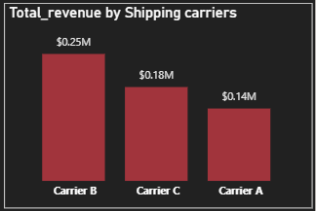

Logistics Performance
Shipping Revenue Handled
Carrier B $250K+ █████████████
Carrier C $180K █████████
Carrier A $140K ██████
On-Time Delivery: 83%
17% orders delayed → biggest customer complaint risk Average shipping time: 5.75 days
Action: Give 80% volume to Carrier B

Slide 9
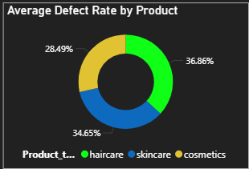
Quality & Defects
Insight
Haircare contributes maximum defects (36.86%)
Many inspections still “Pending” → slow closure
Recommendation
Increase QC staff/checks for Haircare SKUs
Implement 48-hour maximum pending inspection rule
Average Defect Rate: 2.28% Defect Share by Category Haircare 36.86% Skincare 34.65% Cosmetics 28.49%
Top 5 worst SKUs → SKU10, SKU94, SKU9, SKU36, SKU37
Many inspections still “Pending” → slow QC process

Slide 10
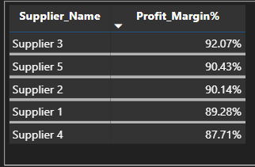
Supplier Ranking
Rank | Supplier | Profit Margin | Recommendation
1 | Supplier 3 | 92.07% | Increase volume
2 | Supplier 5 | 90.43% | Strong performer
3 | Supplier 2 | 90.14% | Reliable
4 | Supplier 1 | 89.28% | Good volume
5 | Supplier 4 | 87.71% | Renegotiate or reduce

Slide 11
Top Insights
Skincare is the growth engine (42% revenue)
89.92% gross margin → excellent premium positioning
Stock turnover numbers are wrong → data quality issue
Cosmetics losing sales daily (only 73% fill rate)
17% delayed deliveries → customer satisfaction risk
Carrier B is the best performer
Supplier 3 & 5 are stars
30% revenue from “Unknown” gender → fix data capture
Recommendation
Skincare = growth engine → invest heavily
89.92% margin → excellent premium strategy
Stock turnover data is corrupted → clean immediately
Cosmetics losing sales daily (73% fill rate)
17% delayed deliveries → customer satisfaction risk
Carrier B is the winner
Supplier 3 & 5 are stars
30% revenue untagged gender → fix data capture

Slide 12
Recommendations & Action Plan
Clean “Number_of_products_sold” column immediately
Increase focus & inventory on Skincare
Fix Cosmetics fulfillment → target >92% fill rate
Shift maximum shipments to Carrier B
Give more business to Supplier 3 & 5
Speed up QC inspection process
Make gender field mandatory in orders
Set alert for any SKU where Sold > Produced
How to Act
Clean “Number_of_products_sold” column (Priority #1)
Increase inventory & marketing budget for Skincare
Fix Cosmetics fulfillment process → target >92% fill rate
Route 80%+ shipments via Carrier B
Give 30% more volume to Supplier 3 & 5
Speed up QC closure (max 48 hrs pending)
Make gender field mandatory
Set monthly data quality audit

Slide 13
THANK YOU

